Slide 1
Spatial structure often inhibits the evolution of cooperation in the snowdrift game
Christoph Hauert & Michael Doebeli
Departments of Zoology and Mathematics, University of British Columbia,
6270 University Boulevard, Vancouver, British Columbia V6T 1Z4, Canada

Slide 2
Abstract
Understanding the emergence of cooperation is a fundamental problem in evolutionary biology.
Evolutionary game theory has become a powerful framework with which to investigate this problem.
Two simple games have attracted most attention in theoretical and experimental studies : the Prisoner’s Dilemma and the snowdrift game (also known as the hawk–dove or chicken game). In the Prisoner’s Dilemma, the non-cooperative state is evolutionarily stable, which has inspired numerous investigations of suitable extensions that enable cooperative behaviour to persist.
In particular, on the basis of spatial extensions of the Prisoner’s Dilemma, it is widely accepted that spatial structure promotes the evolution of cooperation. Here we show that no such general predictions can be made for the effects of spatial structure in the snowdrift game. In unstructured snowdrift games, intermediate levels of cooperation persist.
Unexpectedly, spatial structure reduces the proportion of cooperators for a wide range of parameters.
In particular, spatial structure eliminates cooperation if the cost-to-benefit ratio of cooperation is high.
Our results caution against the common belief that spatial structure is necessarily beneficial for cooperative behaviour.

Slide 3
What is snowdrift games?

Slide 4
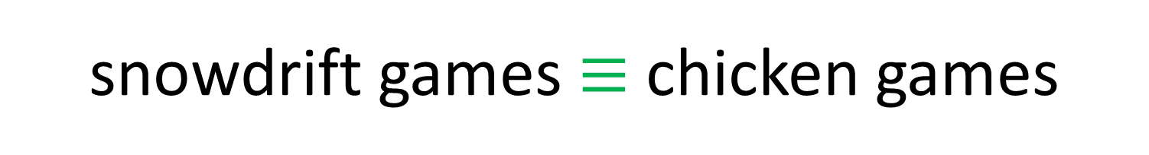
What is snowdrift games?
snowdrift games $≡$ chicken games
(coward)

Slide 5
What is snowdrift games?
snowdrift games $≡$ chicken games
(coward)
VS
Good example of chicken games : car battle

Slide 6
What is chicken games?

Slide 7
What is chicken games?
Crash
Both defector

Slide 8
What is chicken games?
Both are winner but die.
Crash
Both defector

Slide 9
What is chicken games?
Both are winner but die.
Crash
Both defector
Relatively cooperator

Slide 10
What is chicken games?
Winner
Both are winner but die.
Crash
Loser
Both defector
Relatively cooperator

Slide 11
What is chicken games?
Winner
Both are winner but die.
Crash
Loser
Both defector
Relatively cooperator
Both cooperator

Slide 12
What is chicken games?
Winner
Loser
Both are winner but die.
Crash
Loser
Loser
Both defector
Relatively cooperator
Both cooperator

Slide 13
Relation of Prisoners’ Dilemma

Slide 14
Relation of Prisoners’ Dilemma
Fig. 1 :A payoff matrix of Chicken
 | B Swerve | B Straight
A Swerve | Tie, Tie (0/0) | Lose, Win (-5/5)
A Straight | Win, Lose (5/-5) | Crash, Crash (-10/-10)

Slide 15
Relation of Prisoners’ Dilemma
Fig. 1 :A payoff matrix of Chicken
 | B Swerve | B Straight
A Swerve | Tie, Tie (0/0) | Lose, Win (-5/5)
A Straight | Win, Lose (5/-5) | Crash, Crash (-10/-10)
Fig. 2 :A payoff matrix of Prisoners’ Dilemma
 | B stays silent | B betrays
A stays silent | 1 years in prison (-1/-1) | B release, A is 10 years in prison (-10/0)
A betrays | A release, B is 10 years in prison (0/-10) | 5 years in prison (-5/-5)

Slide 16
Relation of Prisoners’ Dilemma
Fig. 1 :A payoff matrix of Chicken
 | B Swerve | B Straight
A Swerve | Tie, Tie (0/0) | Lose, Win (-5/5)
A Straight | Win, Lose (5/-5) | Crash, Crash (-10/-10)
Negative-sum game
as Zerosum game.
Fig. 2 :A payoff matrix of Prisoners’ Dilemma
 | B stays silent | B betrays
A stays silent | 1 years in prison (-1/-1) | B release, A is 10 years in prison (-10/0)
A betrays | A release, B is 10 years in prison (0/-10) | 5 years in prison (-5/-5)
Notes:
이 게임의 죄수는 상대방의 결과는 고려하지 않고 자신의 이익만을 최대화한다는 가정 하에 움직이게 된다. 이때 언제나 협동(침묵)보다는 배신(자백)을 통해 더 많은 이익을 얻으므로 모든 참가자가 배신(자백)을 택하는 상태가 내쉬 균형이 된다. 참가자 입장에서는 상대방의 선택에 상관없이 자백을 하는 쪽이 언제나 이익이므로 합리적인 참가자라면 자백을 택한다. 결국 결과는 둘 모두 5년을 복역하는 것이고, 이는 둘 모두가 자백하지 않고 6개월을 복역하는 것보다 나쁜 결과가 된다.

Slide 17
Relation of Prisoners’ Dilemma
Fig. 1 :A payoff matrix of Chicken
 | B Swerve | B Straight
A Swerve | Tie, Tie (0/0) | Lose, Win (-5/5)
A Straight | Win, Lose (5/-5) | Crash, Crash (-10/-10)
Negative-sum game
as Zerosum game.
Fig. 2 :A payoff matrix of Prisoners’ Dilemma
 | B stays silent | B betrays
A stays silent | 1 years in prison (-1/-1) | B release, A is 10 years in prison (-10/0)
A betrays | A release, B is 10 years in prison (0/-10) | 5 years in prison (-5/-5)
Positive-sum game
as Non-zerosum game.

Slide 18
Relation of Prisoners’ Dilemma
Fig. 1 :A payoff matrix of Chicken
 | B Swerve | B Straight
A Swerve | Tie, Tie (0/0) | Lose, Win (-5/5)
A Straight | Win, Lose (5/-5) | Crash, Crash (-10/-10)
Negative-sum game
as Zerosum game.
Pay-off Inequality : T>R>S>P
Fig. 2 :A payoff matrix of Prisoners’ Dilemma
 | B stays silent | B betrays
A stays silent | 1 years in prison (-1/-1) | B release, A is 10 years in prison (-10/0)
A betrays | A release, B is 10 years in prison (0/-10) | 5 years in prison (-5/-5)
Positive-sum game
as Non-zerosum game.
Pay-off Inequality : T>R>P>S

Slide 19
Assumptions in snowdrift games

Slide 20
Assumptions in snowdrift games
The car owners’ choice
shovelling (Cooperate)
remain in the car (Defect)

Slide 21
Assumptions in snowdrift games
The car owners’ choice
shovelling (Cooperate)
remain in the car (Defect)
 | B shovel | B remain
A shovel | Both can go home | Both can go home but A get an additional cost
A remain | Both can go home but B get an additional cost | Both die

Slide 22
Assumptions in snowdrift games
Let $c$ : labor and $b$ : pay-off, then

Slide 23
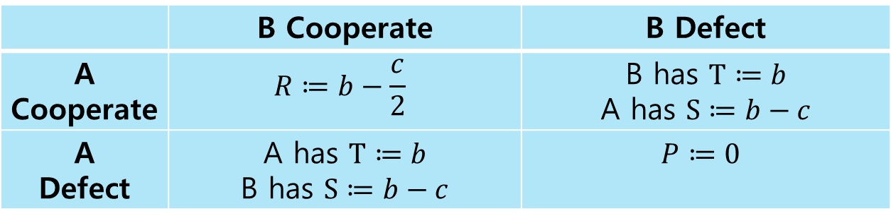
Assumptions in snowdrift games
Let $c$ : labor and $b$ : pay-off, then
 | B Cooperate | B Defect
A Cooperate | $$R≔b−\frac{c}{2}$$ | B has $T≔b$ A has $S≔b−c$
A Defect | A has $T≔b$ B has $S≔b−c$ | $$P≔0$$

Slide 24
Assumptions in snowdrift games
Let $c$ : labor and $b$ : pay-off, then
 | B Cooperate | B Defect
A Cooperate | $$R≔b−\frac{c}{2}$$ | B has $T≔b$ A has $S≔b−c$
A Defect | A has $T≔b$ B has $S≔b−c$ | $$P≔0$$
If $2b>c>b>0$ , then

Slide 25
Assumptions in snowdrift games
Let $c$ : labor and $b$ : pay-off, then
 | B Cooperate | B Defect
A Cooperate | $$R≔b−\frac{c}{2}$$ | B has $T≔b$ A has $S≔b−c$
A Defect | A has $T≔b$ B has $S≔b−c$ | $$P≔0$$
If $2b>c>b>0$ , then
pay-off inequality $≡$ Prisoners’ Dilemma
T>R>P>S

Slide 26
Assumptions in snowdrift games
Let $c$ : labor and $b$ : pay-off, then
 | B Cooperate | B Defect
A Cooperate | $$R≔b−\frac{c}{2}$$ | B has $T≔b$ A has $S≔b−c$
A Defect | A has $T≔b$ B has $S≔b−c$ | $$P≔0$$
If $2b>c>b>0$ , then
pay-off inequality $≡$ Prisoners’ Dilemma
T>R>P>S
If $b>c>0$ , then

Slide 27
Assumptions in snowdrift games
Let $c$ : labor and $b$ : pay-off, then
 | B Cooperate | B Defect
A Cooperate | $$R≔b−\frac{c}{2}$$ | B has $T≔b$ A has $S≔b−c$
A Defect | A has $T≔b$ B has $S≔b−c$ | $$P≔0$$
If $2b>c>b>0$ , then
pay-off inequality $≡$ Prisoners’ Dilemma
T>R>P>S
If $b>c>0$ , then
pay-off inequality $≡$ snowdrift game
T>R>S>P

Slide 28
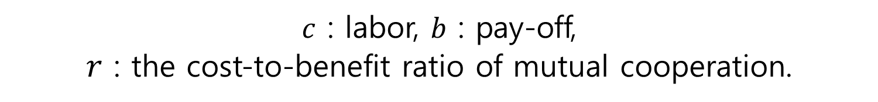

The equilibrium frequency of cooperator in the snowdrift game
${EF}_{C}=1−r$, where $r=\frac{c}{2b−c}$
$c$ : labor, $b$ : pay-off,
$r$ : the cost-to-benefit ratio of mutual cooperation.

Slide 29
On a lattice
An important insight is that spatial structure can promote persistence of cooperation.
In particular, if the Prisoner’s Dilemma is played in spatially structured populations, in which individuals interact only within a limited local neighbourhood, then cooperation can be maintained. Here we investigate the effects of spatial structure in the snowdrift game.
To model spatial structure, we assume that individuals occupy sites on a regular lattice.

Slide 30
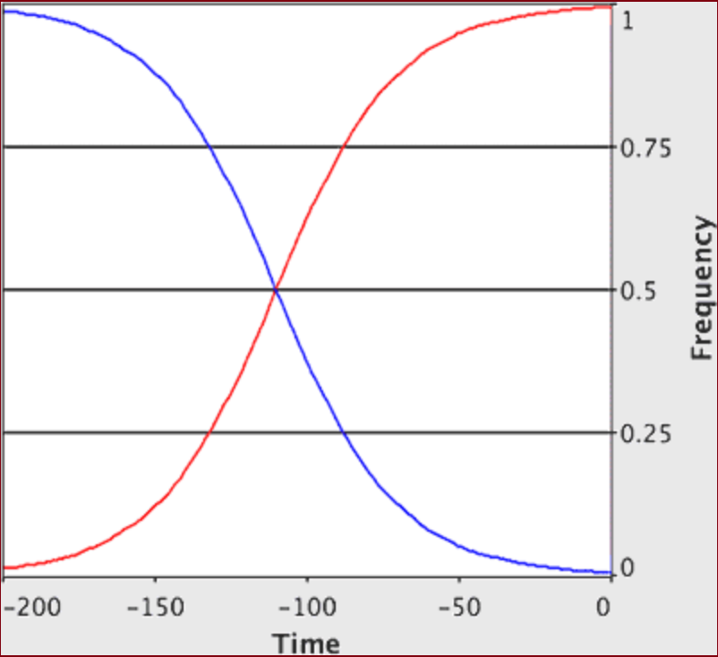
In well-mixed population
Defector
Cooperator

Slide 31
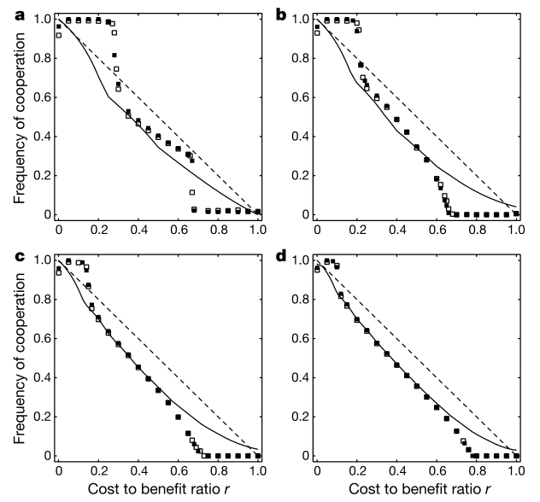



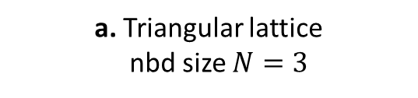
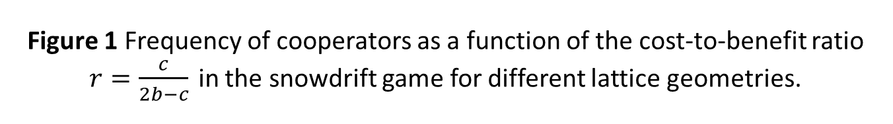
Figure 1 Frequency of cooperators as a function of the cost-to-benefit ratio $r=\frac{c}{2b−c}$ in the snowdrift game for different lattice geometries.
a. Triangular lattice
nbd size $N=3$
b. Square lattice
nbd size $N=4$
c. Hexagonal lattice
nbd size $N=6$
d. Square lattice
nbd size $N=8$
asynchoronous
synchoronous
Well-mixed populations
Pair approximations
Notes:
Well-mixed population : replicator equation 이 협력자와 배반자가 균형이되는 값을 반환하는 것

Slide 32
Largely independent of whether updating is synchoronous or asynchoronous
Notes:
싱크로너스 vs 어싱크로너스 : 동시에 lattice 격자 업데이트 vs 순차적 lattice 업데이트

Slide 33
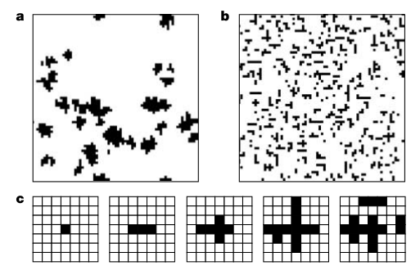
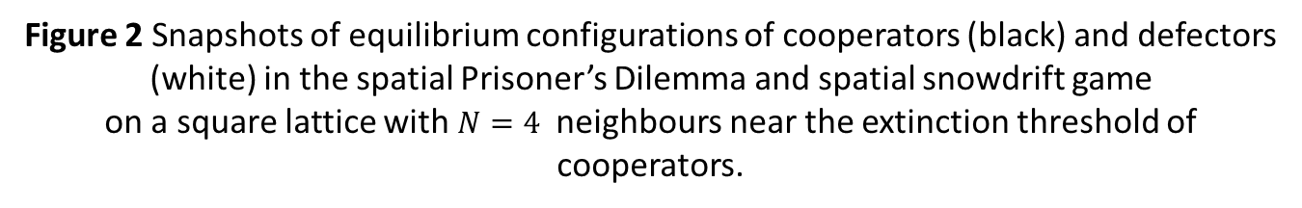
Figure 2 Snapshots of equilibrium configurations of cooperators (black) and defectors (white) in the spatial Prisoner’s Dilemma and spatial snowdrift game on a square lattice with $N=4$ neighbours near the extinction threshold of cooperators.
Defector
a. In Prisoners’ Dilemma, $R=1, T=1.07, S=−0.07, P=0$
Cooperator
b. In snowdrift game, $R=1, T=1.62, S=0.38, P=0$
c. Microscopic pattern formulation in the snowdrift game

Slide 34
Introduction of hawk-dove game

Slide 35
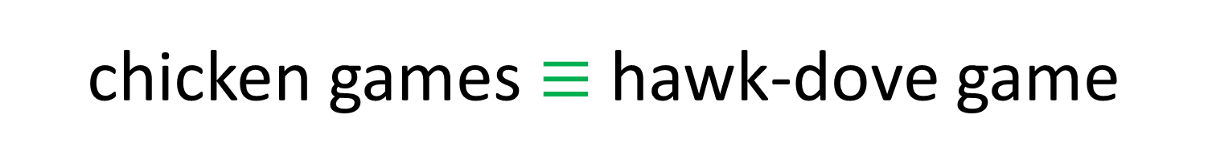
Introduction of hawk-dove game
chicken games $≡$ hawk-dove game
("The logic of animal conflict“)

Slide 36


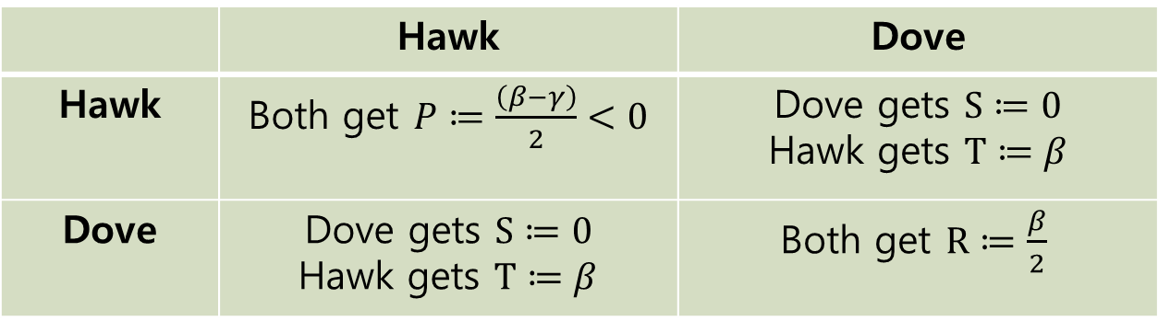
Introduction of hawk-dove game
chicken games $≡$ hawk-dove game
("The logic of animal conflict“)
 | Hawk | Dove
Hawk | Both get $P≔\frac{\left(β−γ\right)}{2}<0$ | Dove gets $S≔0$ Hawk gets $T≔β$
Dove | Dove gets $S≔0$ Hawk gets $T≔β$ | Both get $R≔\frac{β}{2}$
A fitness loss $γ (γ>β)$ ,
Resource $β$ ,
Notes:
Fitness loss (체력감소), resource (자원)

Slide 37
Introduction of hawk-dove game
chicken games $≡$ hawk-dove game
("The logic of animal conflict“)
 | Hawk | Dove
Hawk | Both get $P≔\frac{\left(β−γ\right)}{2}<0$ | Dove gets $S≔0$ Hawk gets $T≔β$
Dove | Dove gets $S≔0$ Hawk gets $T≔β$ | Both get $R≔\frac{β}{2}$
A fitness loss $γ (γ>β)$ ,
Resource $β$ ,
When$(γ≤β$ , hawk-dove ≡ Prisoners’ Dilemma
Notes:
Fitness loss (체력감소), resource (자원)

Slide 38
Introduction of hawk-dove game
chicken games $≡$ hawk-dove game
("The logic of animal conflict“)
 | Hawk | Dove
Hawk | Both get $P≔\frac{\left(β−γ\right)}{2}<0$ | Dove gets $S≔0$ Hawk gets $T≔β$
Dove | Dove gets $S≔0$ Hawk gets $T≔β$ | Both get $R≔\frac{β}{2}$
A fitness loss $γ (γ>β)$ ,
Resource $β$ ,
When$γ≤β$ , hawk-dove ≡ Prisoners’ Dilemma
When $b≔\frac{(β+γ)}{2}, β=c$ , hawk-dove ≡ snowdrift
Notes:
Fitness loss (체력감소), resource (자원)

Slide 39
Why we using hawk-dove game
When studying cooperation, it is often useful to allow for continuously varying degrees of cooperative behaviour, which can be achived by considering mixed strategies describing an individual’s propensity to cooperate.
A pure strategy provides a complete definition of how a player will play a game. In particular, it determines the move a player will make for any situation he or she could face. A player's strategy set is the set of pure strategies available to that player.
A mixed strategy is an assignment of a probability to each pure strategy. This allows for a player to randomly select a pure strategy. (See the following section for an illustration.) Since probabilities are continuous, there are infinitely many mixed strategies available to a player.
Notes:
순수전략 : 직면한 상황에 어떻게 행동할지 규칙에 따라 다 결정해놓은 것
혼합전략 : 순수전략 여러 개를 정해놓고 확률에 따라 순수전략을 고르는 전략

Slide 40

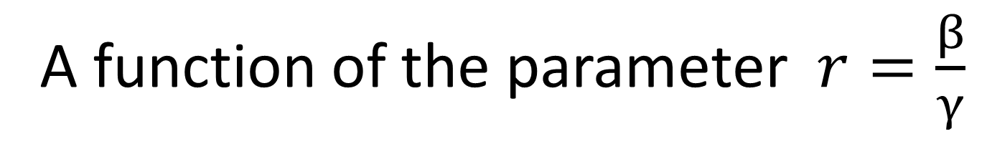



A function of the parameter$r=\frac{β}{γ}$
$$f_{Hawk}=r$$
$$f_{Dove}=1−r$$
A fitness loss $γ (γ>β)$ ,
Resource $β$
$r$ : the cost-to-benefit ratio,
$f_{Dove}$ : evolutionarily stable mixed strategy

Slide 41
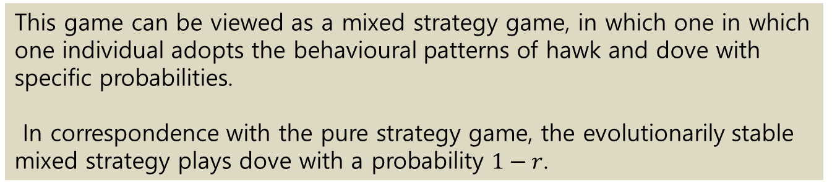
A function of the parameter$r=\frac{β}{γ}$
$$f_{Hawk}=r$$
$$f_{Dove}=1−r$$
A fitness loss $γ (γ>β)$ ,
Resource $β$
$r$ : the cost-to-benefit ratio,
$f_{Dove}$ : evolutionarily stable mixed strategy
This game can be viewed as a mixed strategy game, in which one in which one individual adopts the behavioural patterns of hawk and dove with specific probabilities.
In correspondence with the pure strategy game, the evolutionarily stable mixed strategy plays dove with a probability $1−r$.

Slide 42
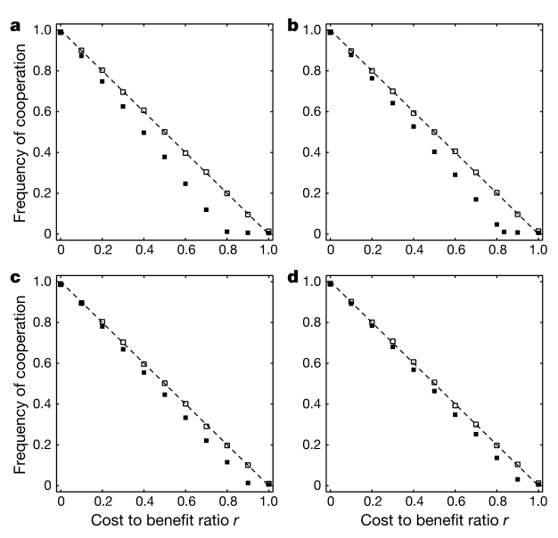

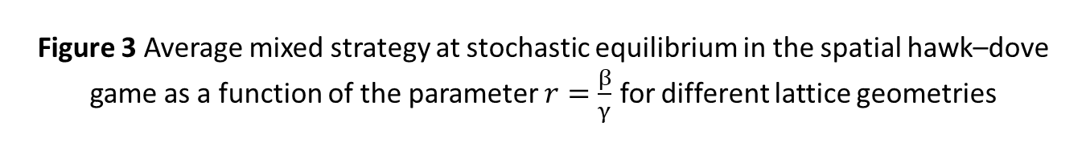


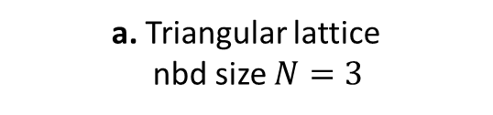
Figure 3 Average mixed strategy at stochastic equilibrium in the spatial hawk–dove game as a function of the parameter $r=\frac{β}{γ}$ for different lattice geometries
a. Triangular lattice
nbd size $N=3$
b. Square lattice
nbd size $N=4$
c. Hexagonal lattice
nbd size $N=6$
d. Square lattice
nbd size $N=8$
asynchoronous
synchoronous
Well-mixed populations

Slide 43
Results
Our results show that spatial extension generally fails to promote cooperative behaviour in the hawk–dove or snowdrift game.
In contrast to the Prisoner’s Dilemma, the snowdrift game is a simple model for the evolution of cooperation when defection is not an evolutionarily stable strategy.
We therefore conclude that spatial structure may be rarely beneficial, but often detrimental, to cooperation in such schemes.
Evolutionarily Stable Strategy [ESS] :
For the two strategies, S, T,
S is an Evolutionarily Stable Strategy if S satisfies that conditions
E(S,S) > E(T,S) for all T≠S or
E(S,S) = E(T,S) and E(S,T) > E(T,T) for all T≠S ,
where E(A,B) : an expected benefit that an individual of strategy A gets when
individual of A and B are competing each other

Slide 44
Results
Even though determination of payoff matrices in real systems is notoriously difficult, our results may be relevant for many natural populations.
(ex) Predator inspection in sticklebacks in Prisoners’ Dilemma -> snowdrift.
RNA phages in Prisoners’ Dilemma -> snowdrift (selection alters the
pay-off structure)
Alarm calls in meerkat and fighting in large ungulates in snowdrift or
hawk-dove game.
Overall, our results indicate that spatial extension of natural populations may decrease cooperation and lead to more frequent escalations of conflicts in situations in which cooperation persists in well-mixed populations. Thus, spatial structure may not be as universally beneficial for cooperation as previously thought.
Notes:
Sticklebacks(큰가시고기), notoriously (악명높게)

Slide 45
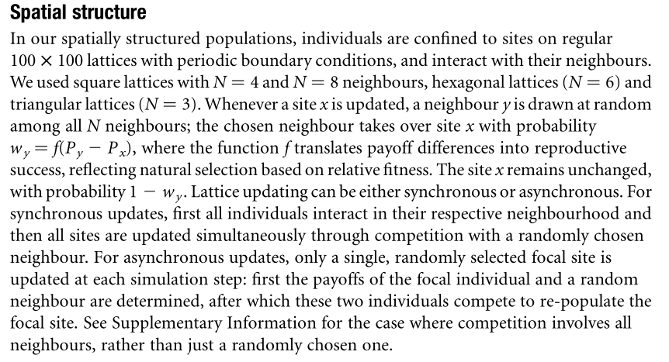
Methods
Notes:
Sticklebacks(큰가시고기), notoriously (악명높게)

Slide 46
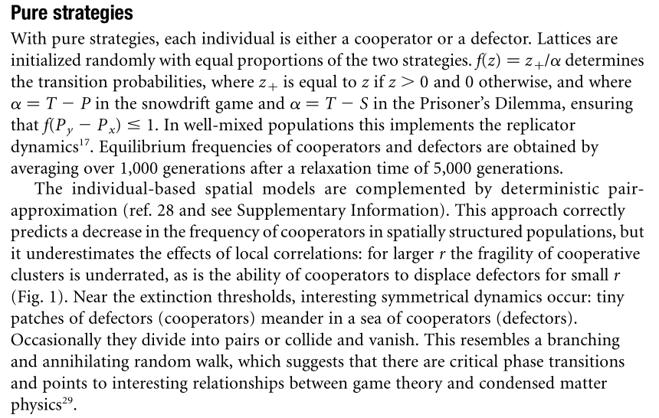
Methods
Notes:
Sticklebacks(큰가시고기), notoriously (악명높게)

Slide 47
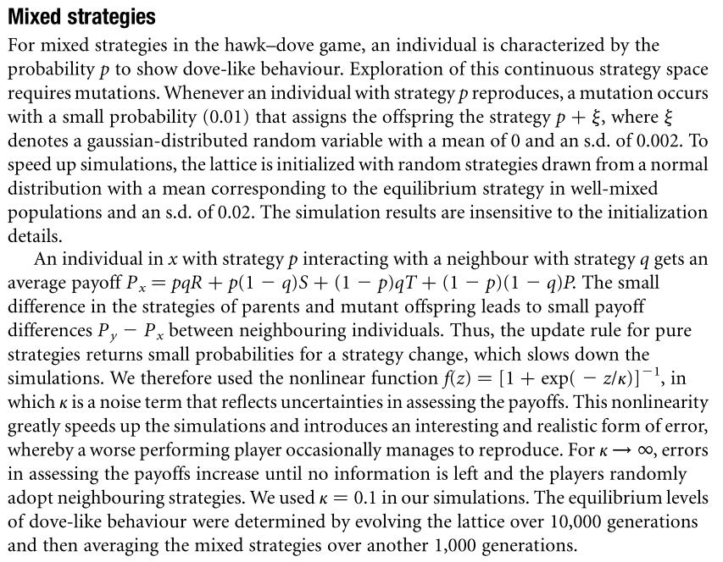
Methods
Notes:
Sticklebacks(큰가시고기), notoriously (악명높게)

